Slide 1
Section 1.2 Introduction to Domain and Range & Non Linear Functions
© Copyright all rights reserved to Homework depot: www.BCMath.ca

Slide 2
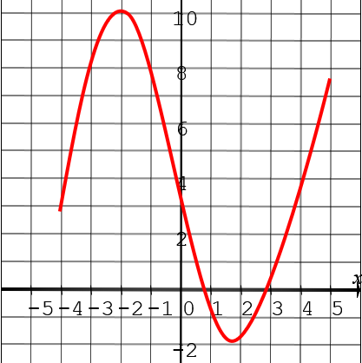
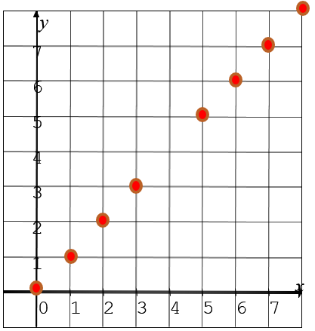
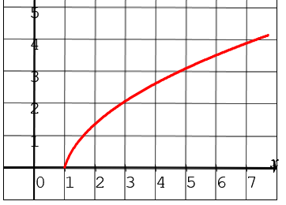
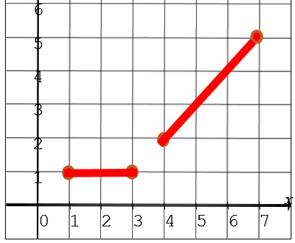
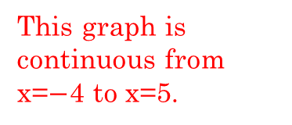
I) Domain of a Function (Restrictions on Input)
Any restriction that you have on the input value is the domain
Graphically, you can find the domain by looking at which way the graph opens towards (left or right) and where it begins
It’s also important to look at whether if the graph is continuous or broken up into smaller parts
This root function begins at x=1 and opens to the right
This graph is continuous from x=$−$4 to x=5.
This graph is discontinuous and take on integers from 0 to 8 but not 4
This graph is continuous x=1 to 3 and from x=4 to 7

Slide 3
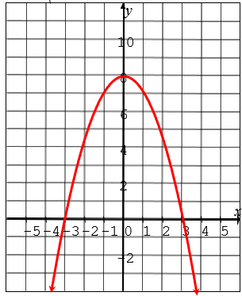
II) Range of a Function: (Restrictions on Output)
Any restrictions on the output values will be the range of the function
Graphically, we are looking at whether if a graph is opening up or down, and also if it is continuous or discontinuous
y
7
6
5
4
3
2
1
x
0
1
2
3
4
5
6
7
This parabola has a max at y = 8 and opens down
This root function opens down from y=4.
This graph is discontinuous and take on integers from 0 to 8 but not 4
This graph is discontinuous and take on integers from 2 to 5 and also y=1

Slide 4
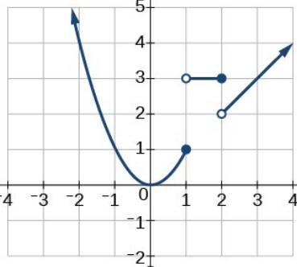
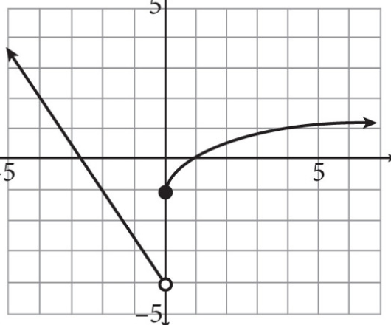
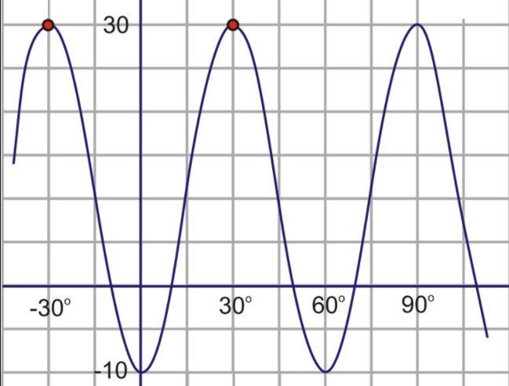
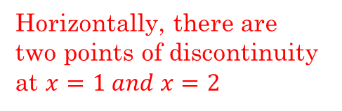
Ex: Indicate the domain and range for each of the following functions:
Horizontally, this graph stretches from left to right, no discontinuity
Horizontally, there are two points of discontinuity at $x=1 and x=2$
Vertically, highest point is 30 and lowest point is 10
Despite the point of discontinuity, the left side of the graph is continuous. Minimum point is 0

Slide 5
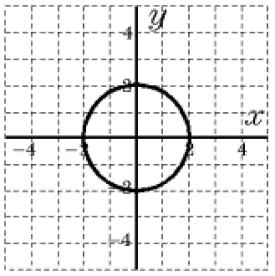
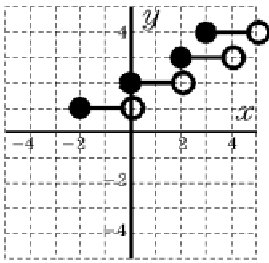
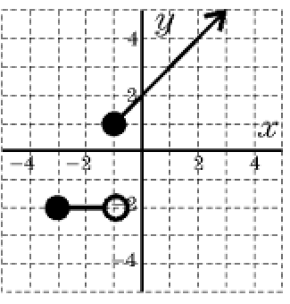
Given each graph below, match it with the correct domain and range:

Slide 6
Ex: Find the domain and range of each scenario:
i) John has $5 to buy donuts at Tim Hortons. Each donut costs $1.25
ii) Wendy takes a taxi. The base cost is $2.50 and she is charged $1.50 per minute after the first 5 minutes
iii) Your weight is a function of your age. The lightest baby ever recorded is 250g, the heaviest person ever is 392lbs and the oldest person claimed to have lived 122 years.

Slide 7
III) Terms:
A function is a “rule or equation” that produces a single output number for each input number, meaning its 1 to 1
The values put into the function is the “input number” X-coordinate [Domain]
The values you get out of a function is the “output number”, Y-coordinate [Range]
Non Linear Functions: Functions that are not straight lines:
Quadratics, Radicals, Rationals, Exponentials, etc….
Transformation Functions: Functions that modifies an existing function
Absolute Value Functions, Inverse Functions
Input numbers have restrictions, it has be acceptable by the function
Ie: Rational Functions can not have an input that makes the denominator equal to zero
Radical functions can not have an input that makes the value inside a root function negative

Slide 8
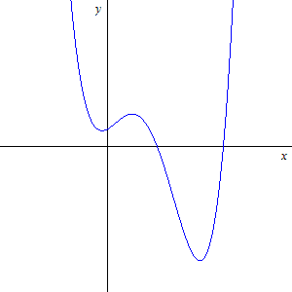
IV) Function Test: The vertical line Test
Remember: A function is an equation where every input value “x” will have only ONE output value “y”
If one “x” generates two or more y-values → NOT a Function
The easiest method to determine whether an equation or graph is a function or not is to perform the vertical line test
Draw a straight VERTICAL line anywhere on your graph
If the line vertical intersects at more than one point along the graph, then it is NOT a function
If the any vertical line you draw intersects at only one point or less then you have a function

Slide 9
Ex: Which of the following are functions? Explain

Slide 10
Examples of Non-linear Functions
Quadratic Functions: (parabola)
Radical (root) Function: (side ways parabola)
“x” is taken to the power of 2
“x” is inside a radical
No limit on domain (input values)
Domain(input) is limited by expression inside the radical
Range(output) is limited by the max or min
The expression inside must always be positive
Exponential Function:
Range(output) is limited by which way the graph opens (up/down). Is there a negative sign in front of the function?
“x” is an “exponent”
No restrictions on the domain (input) values
Range (output) is restricted by which way the graph opens (up / down)

Slide 11
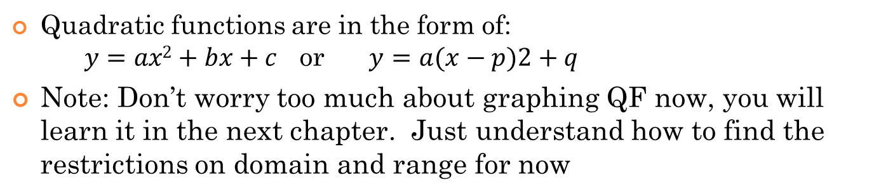
Non Linear Functions: i) Quadratic Functions
In general, quadratic functions have the shape of a parabola
There is not restriction on the input values, so the domain can be all real values
The maximum or minimum point restricts the output values
Positive sign in front → Opens up → Minimum point
Negative sign in front → Opens down → Maximum point
All output values will be greater or equal to -4
All output values will be less than or equal to 7
Quadratic functions are in the form of: $y=ax2+bx+c$ or $y=a(x−p)2+q$
Note: Don’t worry too much about graphing QF now, you will learn it in the next chapter. Just understand how to find the restrictions on domain and range for now

Slide 12
Ex: Given the functions, what are the restrictions on the input and output values?
This is a parabola (QF). There is no restrictions on the input values. So the domain can be all real numbers
INPUT numbers: No restrictions
INPUT numbers: No restrictions
Lowest value is -8, so OUTPUT values are -8 or greater :
There is a negative sign in the front of the squared portion. So that means it will have a max value.
INPUT numbers: No restrictions
Max value is 4.
A parabola will have either a max or min, putting a restriction on the output values.
so OUTPUT values are 4 or less
Lowest value is 3, so OUTPUT values are 3 or greater :

Slide 13
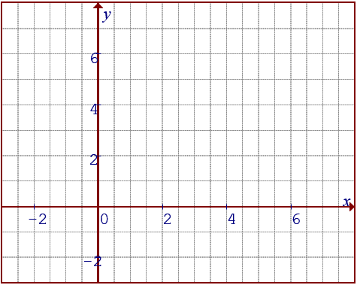
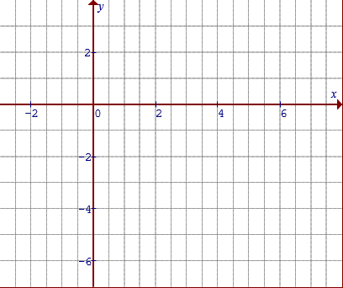
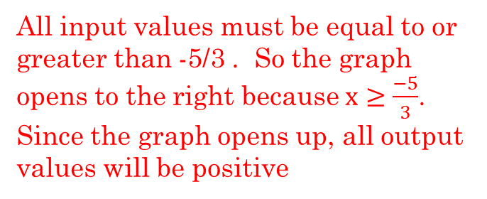
Non-Linear Functions: ii)Root Function
Square roots the input numbers, output value is always positive
The expression inside the radical needs to be positive because you can’t square root a negative value (Input values will be restricted)
Suppose you are given the equation below:
All input values must be equal to or greater than -5/3 . So the graph opens to the right because $x≥\frac{−5}{3}$. Since the graph opens up, all output values will be positive
The negative sign in front will make this graph open downwards. All output values will be negative

Slide 14
Ex: For each of the root functions below, indicate the restrictions on the input/output values. Then match it with the corresponding graph:
Take the expression inside the radical. It must be zero or greater!
INPUT values are -4/3 or smaller. Graph opens to the LEFT
INPUT values are 11/3 or smaller. Graph opens to the LEFT
INPUT values are -4/3 or greater. Graph opens to the right
OUTput values are all negative, since there is a negative sign in front of the radical
OUTput values are all positive
OUTput values are all positive
A
B
C
D

Slide 15
Finding the Domain and Range Algebraically
When looking for the domain of a function, check the denominator or the root of an expression
Denominator can not be zero and you cant square root a negative value
To find the range, use a graph to understand the limit on it’s output values
ie: Parabolas have a max/min, root functions open up/down, linear functions have all real numbers,
Ex: Find the domain and range of each function:

Slide 16
y
y
y
4
4
4
2
2
x
x
2
-5
-4
-3
-2
-1
0
1
2
3
4
5
-2
-1
0
1
2
3
4
5
6
7
8
9
x
-2
-2
-5
-4
-3
-2
-1
0
1
2
3
4
5
Graph opens up, so the range is all positive values and zero
Eqn has a negative sign in front, so it opens down. The range will be all negative values and zero
Graph opens up, but the minus one shifts the whole graph down one unit. The coefficient of “x” is negative, so graph opens to the left!
-2

Slide 17
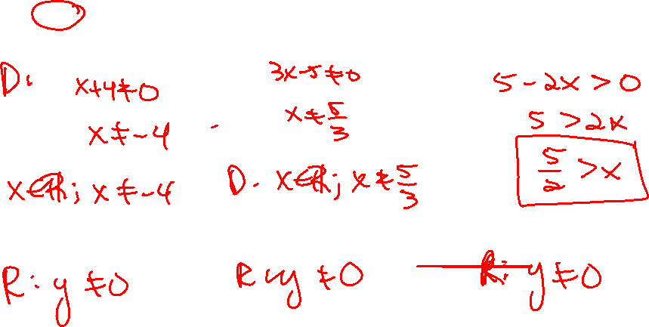

Slide 18
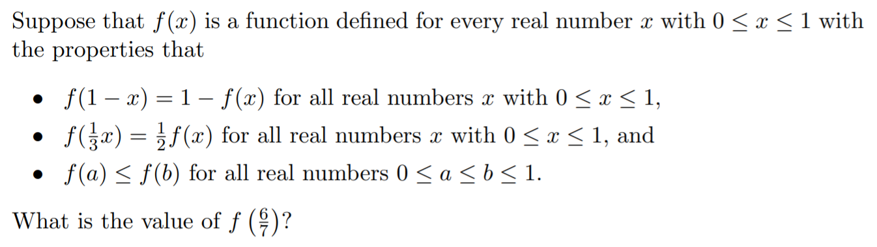
If exactly two different linear functions ‘f” and ‘g” satisfy the equation: $$f\left(f\left(x\right)\right)=g\left(g\left(x\right)\right)=4x+3$$
T$hen what is the product of : f\left(1\right) and g\left(1\right) ?$

